Slide 1


360 Degree MONITORING
TRIBE-O
Business Requirement Document [BRD]

Slide 2
TRIBE : O
BACKEND TEAM | DOCUMENTATION TEAM
PRASAD MOHAN DHUPKAR (CO-LEADER) | ABHAY SINGH BAJETA (LEADER)
OMKAR SAMBHAJI DAMAME | SUNITA KUMARI NAYAK
DEEPAK PANIGRAHI | SANTOSINI SATAPATHY
SUBHANGI SUBHADARSHINI NAYAK | SANTOSHINI NAIK
SIDDIK JAHANGIR ATTAR | BIDYUT RANJAN NAYAK
 | ABHIPSA SAMANTRA

Slide 3
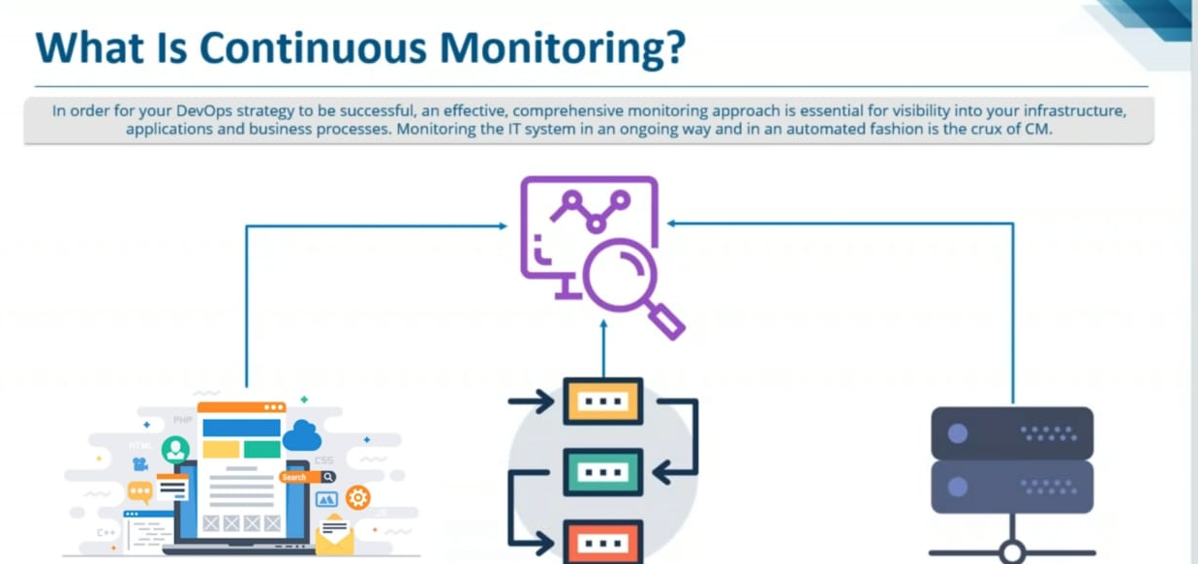

Slide 4
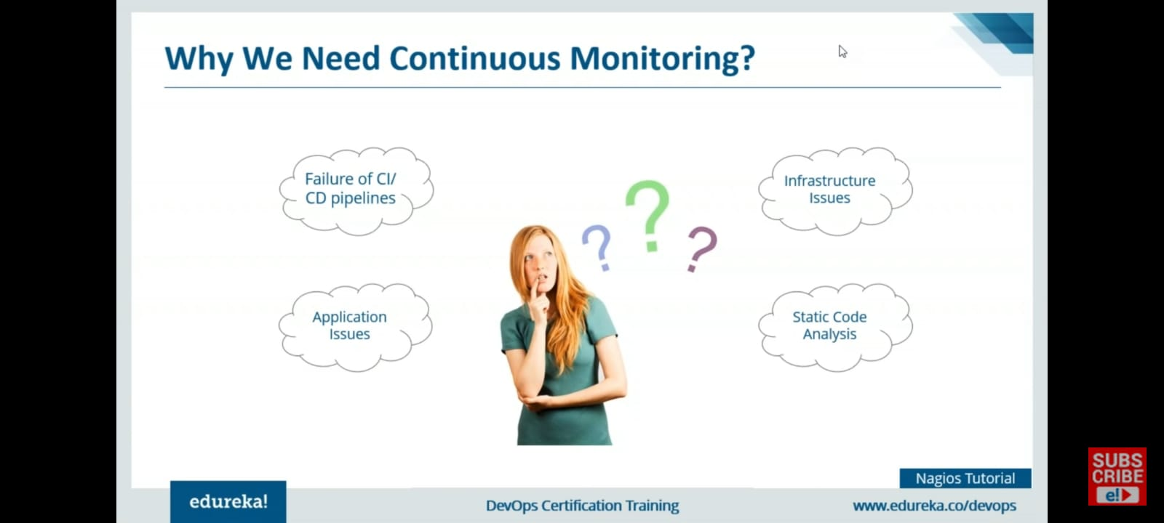

Slide 5
What Is 360⁰ Monitoring
360 degree monitoring is a full fledged monitoring provided to the customer server, application, database and network so as to make sure their business is not halted at any cost.

Slide 6
Why 360⁰ monitoring
Get complete visibility into your server health and performance
Frees up your IT resources
Improve end-user experience
Reduce downtime
Boost up Innovation

Slide 7
Difference between Centralized and Decentralized monitoring
Centralized Monitoring
Servers push to a centralized collection platform
High load of network traffic
Monitoring can become bottleneck
Decentralized Monitoring
Systems with units of computation that are physically or logically distributed.
Low load on network traffic

Slide 8
Tools and services we used
NAGIOS – Monitoring Tool
POSTFIX – Push Notification Tool
ZABBIX – Monitoring Tool
AWS – Provides Infrastructure

Slide 9
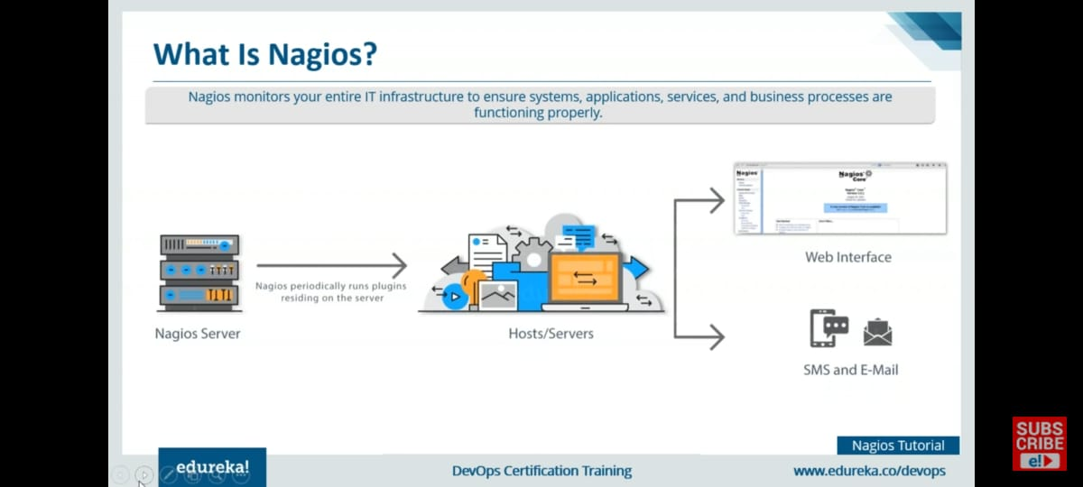
Nagios

Slide 10
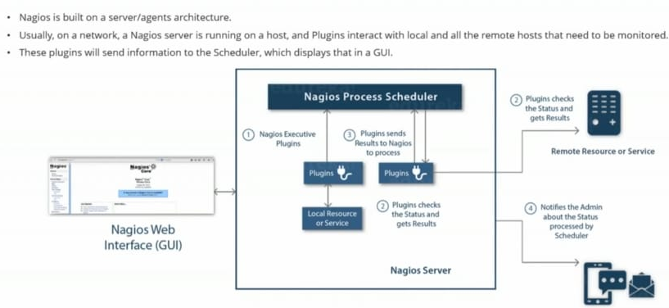
How Does Nagios Work - Architecture

Slide 11
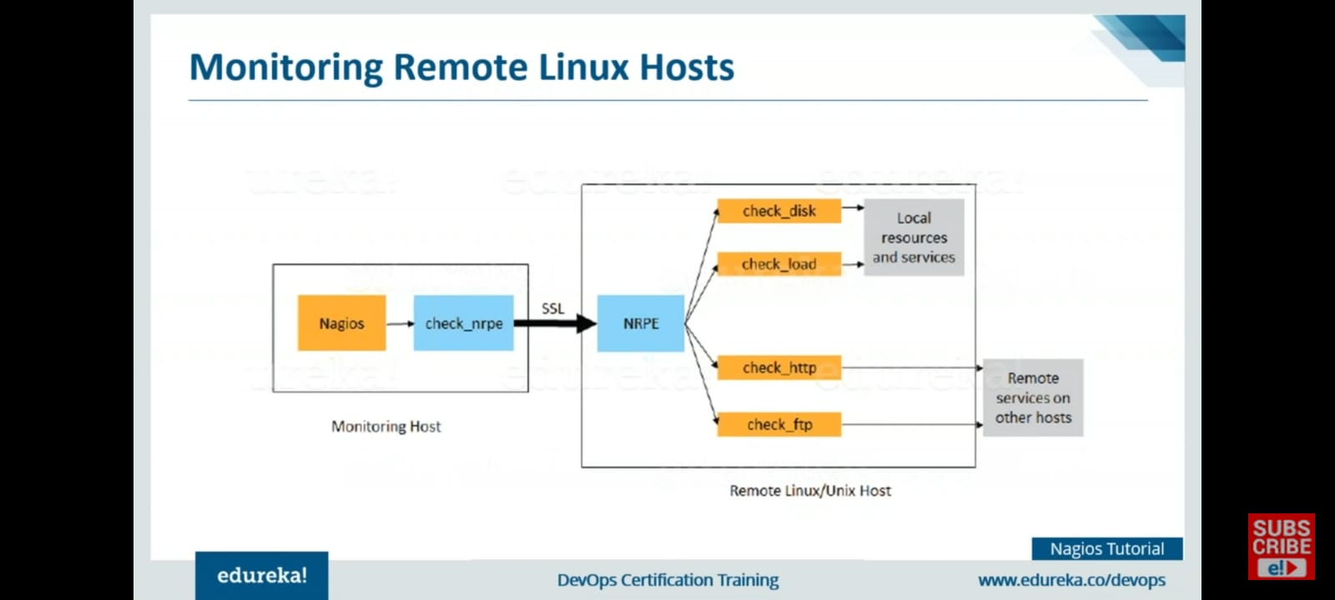

Slide 12
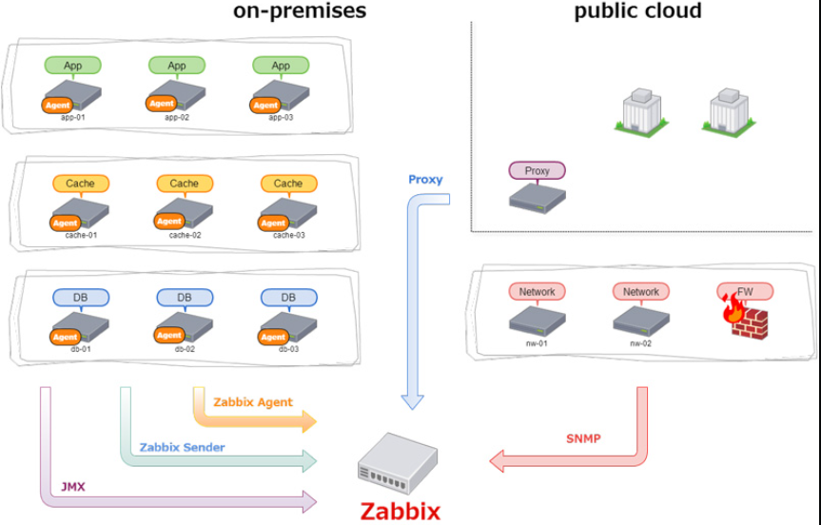
Zabbix
Zabbix is an open source monitoring software tool for diverse IT components, including networks, servers, virtual machines (VMs) and cloud services

Slide 13
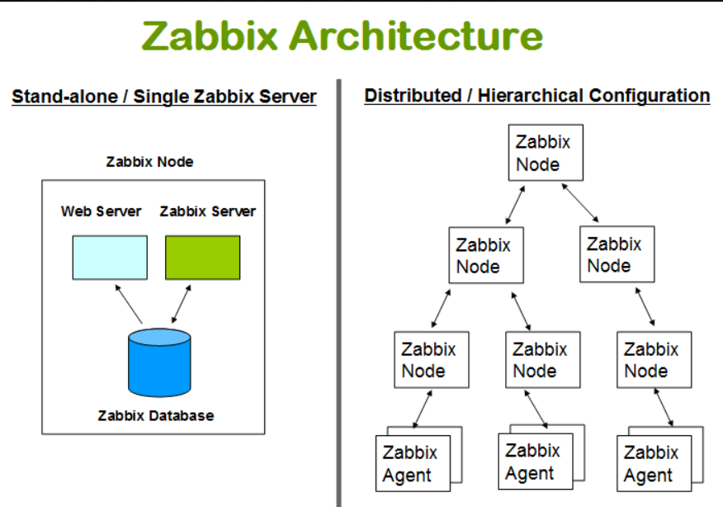
How Does Zabbix Work - Architecture
Zabbix uses client-server Architecture and uses an agent in the servers that should be monitored. This agent gathers all needed information and status from the system and sends to Zabbix server.
We are doing Stand-alone /Single Zabbix Server.

Slide 14
What do we offer
Server Monitoring
Webserver/Application Monitoring
Database Monitoring

Slide 15
Flow of project
Ubuntu 20.04 LTS CLI is required on EC2 instance.
Assigned IAM roles for collaborative work.
Assigned Elastic IP to all the instances.
Installed Nagios on host and remote.
Configured Plugins and NRPE on every instance.
Edited config file of Nagios and NRPE to add monitoring according to our need.
Deployed Webserver to monitor it.
Initiated MySQL database to monitor it.
Did Set up Postfix mailing service for Nagios; for alerting the Admin incase of any fault.
Installed another Open Source monitoring tool Zabbix to make it decentralized monitoring.
Configured Zabbix on remote and host.
Interlinked Zabbix and Nagios in order to if one goes down, others will inform the Admin.

Slide 16
Challenges faced throughout.
Challenges
Setting up mailing service for Nagios
Setting up NRPE
Could not assign Elastic IPs to all our 7 instances.(as AWS only allows 5)
Had to face compatibility issues with OS
How we handled them
Did it through trial and error and official documentation.
Gone through various CLI logs.
Had to contact to AWS support team to request quota increase.
Tried on multiple OS to troubleshoot.

Slide 17
Why Not AWS CloudWatch
Although using CloudWatch would been more easier as our project is totally hosted on AWS, but we choose not to use it because:
CloudWatch is centralized and could become slow when there are multiple push request from many services.
It is not an Open Source monitoring tool which affects privacy and security for companies.
CloudWatch is very expensive when compared to Open Source tools like Nagios and Zabbix which are 100 percent free to use.

Slide 18
THANK YOU

